Slide 1
Done by:
Saeed Jibril & Jafar AL-Masri

Slide 2
Outlines
Objectives.
Definition of learning disabilities.
Causes.
Diagnosis
Types.
Article.
Nursing interventions .
Summary.
Conclusion.
References.

Slide 3
objectives
At the end of this seminar the students will be able to :-
1.Define the meaning of learning disabilities.
2.Recognize the types, causes of learning disabilities.
3.Identify the care for slow learner as community health nurse.

Slide 4
Defining learning disability.
-Learning disabilities are neurologically-based processing problems. These processing problems can interfere with learning basic skills such as reading, writing and/or math.
-disorder that affects the brain’s ability to receive, process, store, and respond to information.
-The hallmark sign of a learning disability is “a distinct and unexplained gap between a person's level of expected achievement and their performance”.

Slide 5
learning disability.
Learning disabilities should not be confused with learning problems which are primarily the result of visual, hearing, or motor disabilities ; of mental retardation; of emotional disturbance; or of environmental, cultural or economic disadvantages.

Slide 6
learning disability.
Learning disabilities can affect a person’s ability in one or more of the following areas:
Listening
Speaking
Reading
Writing
Spelling
Reasoning
Mathematics

Slide 7
Causes
Learning disabilities are presumed to be disorders of the central nervous system and a variety of factors may contribute to their occurrence. Learning disabilities may be due to:
1.Heredity.
2. Problems during pregnancy and childbirth(use of drugs and alcohol during pregnancy, prolonged labor or lack of oxygen, premature birth ).

Slide 8
Causes.
3. Metabolic disorder such as phenylketonuria.
4. illness or injury in early childhood affecting brain development, for example a road traffic accident .
5. infections of mothers during pregnancy.

Slide 9
Diagnosis.
full evaluation for a learning disability includes the following³:
1.A medical examination, including a neurological exam, to identify or rule out other possible causes of the child's difficulties, including emotional disorders, intellectual and developmental disabilities, and brain diseases
2.Exploration of the developmental, social, and school performance
3.A discussion of family history Academic achievement testing and psychological assessment

Slide 10
Nursing diagnosis
Impaired verbal communication
Impaired memory
Low self-esteem
Ineffective role performance
Anxiety
Risk for injury
Risk for suicide
ineffective coping
Impaired social interaction

Slide 11
Types Of LDs.
1.Dyslexia.
2.Dyscalculia.
3.Dyspraxia.
4.Dysgraphia.

Slide 12
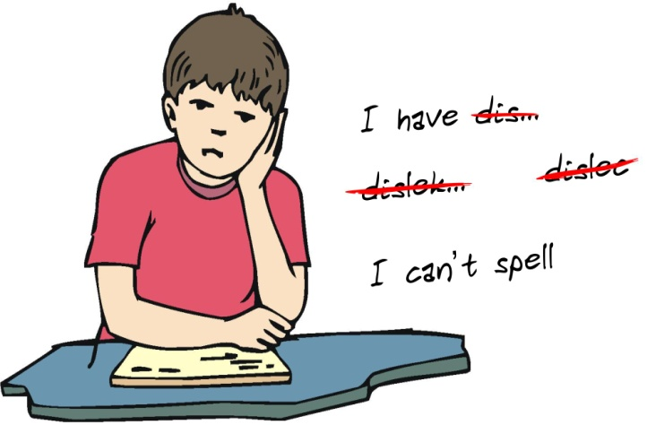
Dyslexia
Learning disabilities in reading
Eg : 6 – 9
M –W

Slide 13
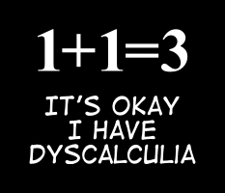
dyscalculia.
Learning disabilities in math.

Slide 14
Dyspraxia
Is a motor coordination disability, it can affect the development of gross motor skills like walking or jumping .

Slide 15
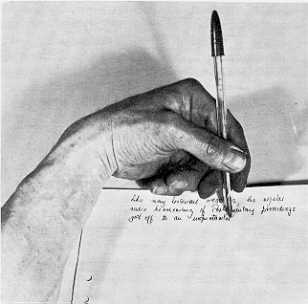
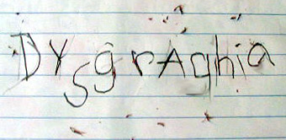
Dysgraphia.
-Affects a person’s handwriting ability and fine motor skills.

Slide 16
Article
Specific learning disability in children : role of the primary care provider.
Author : Erik von hahn
Last updated : Oct 2,2016

Slide 17
What does a learning disability nurse do?

Slide 18
Nursing intervention
- Evaluation and management of learning disabilities.
- Assist in the identification of learning disability.
- Assure management of learning disability.
- Serving as a resource to families about community services.
- Advocating for the child’s rights and needs at school .

Slide 19
- Serving as a mediator between the family and the school team.
- Serving as a consultant and resource to the school team.
- Provide self-esteem and social skills of child.
- Remember that the occurrence of errors does not mean failure.
-Teach your child through the strengths.

Slide 20
مراكز تشخيصية للكشف المبكر عن صعوبات التعلم
مركز للتشخيص الاعاقات المبكرة ( عمان )
مركز الامير حسن للتشخيص المبكر اللاعاقات (الكرك )
مستشفى ايدون العسكري ( اربد )
مركز فرح للتاهيل (عمان )
مركز بسمة لصعوبات التعلم والنطق ( الكرك )

Slide 21
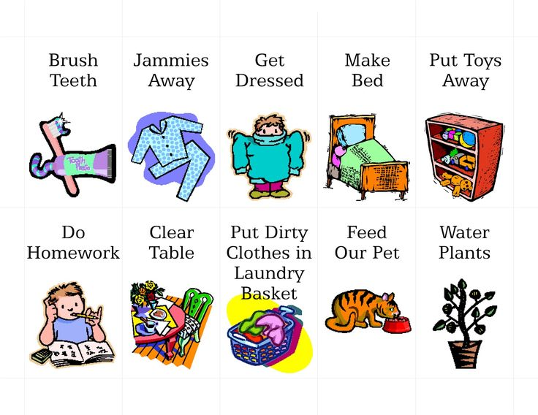
* helping to enable clients to have full and
independent lives

Slide 22
Conclusion.
If you suspect that your child's learning difficulties may require special assistance, please do not delay in finding support. The sooner you move forward, the better your child's chances for reaching his or her full potential.

Slide 23
References.
- Community health nurse book , edition 4th .
- www.uptodate.com .

Slide 24
The End

